Slide 1
Criminal Law Data Analysis – Puerto Rico Edition
Student: Donnie Aikins, Salve Regina University, donnie.aikins@salve.edu
Mentor: Carlos Paniagua, Salve Regina University,
carlos.paniaguamejia@salve.edu
Researcher: Diego Alcala, Defensoría Legal

Slide 2
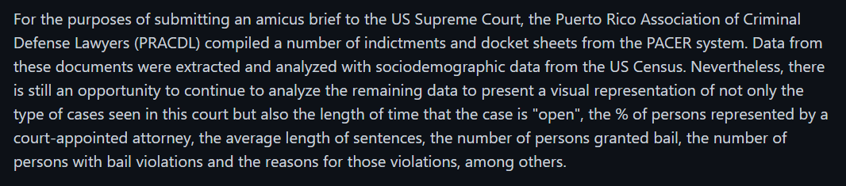
Criminal Law Data Analysis – Puerto Rico Edition

Slide 3
Criminal Law Data Analysis – Puerto Rico Edition
Goals
  Present visual representations
  Provide insight
  Produce statistical testing and/or modelling

Slide 4
Criminal Law Data Analysis – Puerto Rico Edition
Timeframe
  Start Date: 10/01/2021
  End Date: 03/31/2022
  Researcher Presentation: 05/19/2022

Slide 5
Criminal Law Data Analysis – Puerto Rico Edition
What we accomplished
  Successful parse of indictments and dockets
  Visual representations

Slide 6
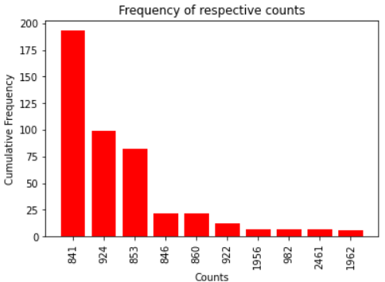
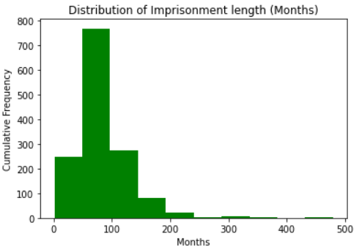
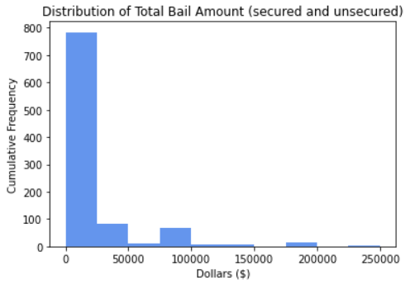
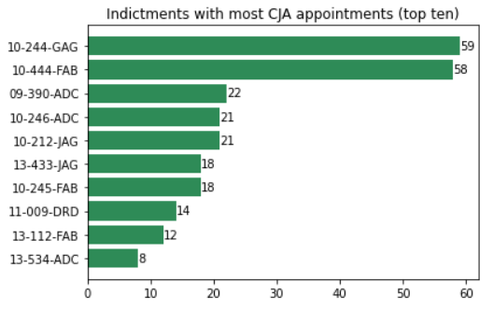
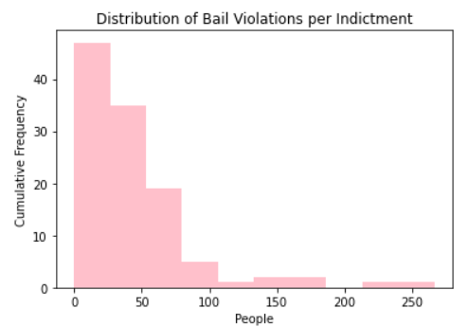

Slide 7
Lessons Learned
What went well?
What could be done differently?
Access to URI computing resources
Better understanding of law
  Indictments and dockets
  Counts
  Process of sentencing, probation
Feedback from researcher
  Impressed
  Proved insights provided value to research
Inconsistency of data
  Parser (python) failed to achieve 100% accuracy
  Data manipulation manually or through iterative code
More data needed to run statistical tests/modelling
  PACER system
  Hypothesis testing
  ANOVA

Slide 8
Final
Incorporation with Researcher
  Interest in publishing works
GitHub Repo
  Private repo;
  https://github.com/cpaniaguam/us_court_pr_project

Slide 9
Publications/Contributions
List any papers or posters that you or your researcher authored or plan to author that incorporate work from this project

Slide 10
Contributions to Research
Computing Community
Please include links and topics!
Ask.CI contributions
  https://ask.CI
Cyberteam Resources contributions
  https://necyberteam.org/resources
Github contributions
  https://github.com/necyberteam
Other?

