Slide 1
UNDERSTANDING THE COVID-19 PANDEMIC THROUGH SOCIAL MEDIA DISCUSSION
Brenna Rojek, Bryant University
brojek@bryant.edu, (401)595-3215
Suhong Li, Bryant University
sli@bryant.edu
Gaurav Khanna, University of Rhode Island
gkhanna@bryant.edu
July 20th, 2022

Slide 2
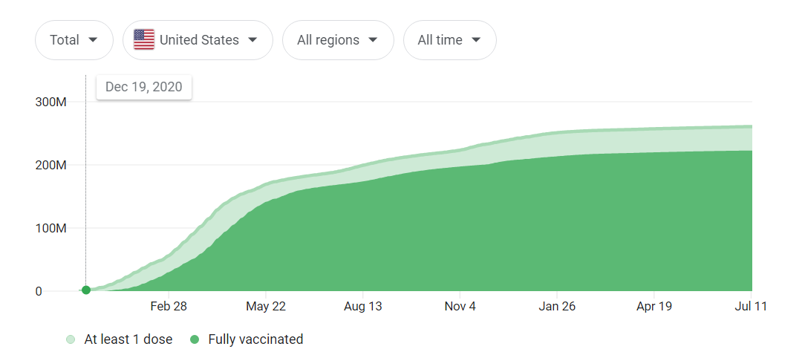
UNDERSTANDING THE COVID-19 PANDEMIC THROUGH SOCIAL MEDIA DISCUSSION
The project will explore a dataset of over 13 million tweets with the keywords related to COVID-19 and ‘vaccine’ or ‘vax’, spanning from March 2020 to March 2022. This project will use machine learning and natural language processing in Python to implement topic modeling and sentiment analysis on the tweets in the dataset.
Notes:
https://www.google.com/search?q=covid+vaccine+timeline&rlz=1C1CHBF_enUS898US898&oq=covid+vaccine+timeline&aqs=chrome..69i57j0i512l8j0i20i263i512.3049j0j7&sourceid=chrome&ie=UTF-8#cobssid=s&colocmid=/m/09c7w0&coasync=0

Slide 3
UNDERSTANDING THE COVID-19 PANDEMIC THROUGH SOCIAL MEDIA DISCUSSION
GOALS
Study polarization of public health topics
Americans use social media as a platform to obtain news
This project will explore Twitter discourse around the topic of COVID-19, seeking to understand which users or topics dominate discourse. The broader significance of this project is to gain insight on how information* is spread on the Twitter platform. Hugging Face machine learning will be used to predict the emotion of the tweets.
Notes:
Since the emergence of the COVID-19 pandemic, we have seen the polarization and politization of public health topics such as face masks and vaccinations in mass media. According to a study performed by Elisa Shearer and Amy Mitchell, more than half of Americans use social media as a platform to obtain news (Shearer et al., 2021). This project will explore Twitter discourse around the topic of COVID-19, seeking to understand which users or topics dominate discourse. The broader significance of this project is to gain insight on how information* is spread on the Twitter platform.

Slide 4
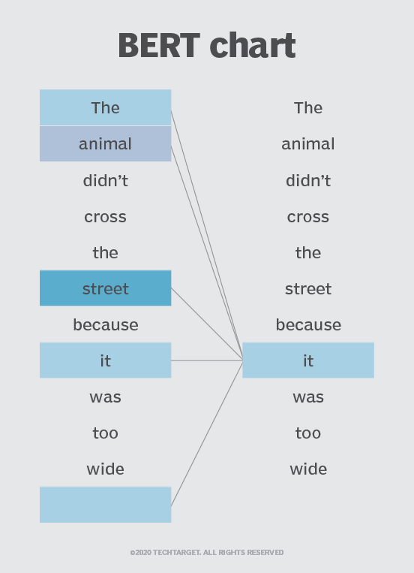
UNDERSTANDING THE COVID-19 PANDEMIC THROUGH SOCIAL MEDIA DISCUSSION
Used Hugging Face Cardiff NLP emotion model
BERT: Bidirectional Encoder Representations from Transformers
  BERT uses transformers to understand words given context: Bidirectional because words change meaning
Uses ROBERTA tokenizer
Applies attention mask
  If sentence is padded, the attention masks signifies which values are important
Model trained on dataset of 60M emotion labeled tweets (https://arxiv.org/pdf/2010.12421.pdf)
Notes:
Since the emergence of the COVID-19 pandemic, we have seen the polarization and politization of public health topics such as face masks and vaccinations in mass media. According to a study performed by Elisa Shearer and Amy Mitchell, more than half of Americans use social media as a platform to obtain news (Shearer et al., 2021). This project will explore Twitter discourse around the topic of COVID-19, seeking to understand which users or topics dominate discourse. The broader significance of this project is to gain insight on how information* is spread on the Twitter platform.

Slide 5
UNDERSTANDING THE COVID-19 PANDEMIC THROUGH SOCIAL MEDIA DISCUSSION
TIMELINE
February
Learn about NLP and conduct preliminary research
March
Launch Presentation & Data Exploration
April
Extensive Analysis using NLP and Machine Learning
June
Interpret Results
July
Conclude Analysis and Wrap Presentation

Slide 6
UNDERSTANDING THE COVID-19 PANDEMIC THROUGH SOCIAL MEDIA DISCUSSION
What we accomplished
  https://public.tableau.com/shared/KYCRFGDWT?:display_count=n&:origin=viz_share_link

Slide 7
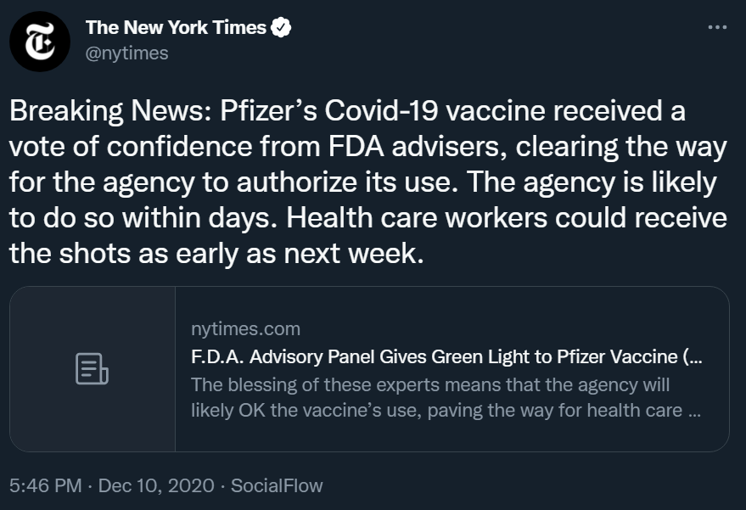
UNDERSTANDING THE COVID-19 PANDEMIC THROUGH SOCIAL MEDIA DISCUSSION
FINDINGS – Topic 1
Emotion
Sadness: -0.76
Anger: -0.72
Joy: 0.58
Optimism: 1.71

Slide 8

UNDERSTANDING THE COVID-19 PANDEMIC THROUGH SOCIAL MEDIA DISCUSSION
FINDINGS – Topic 2
Emotion
Sadness: 0.01
Anger: 2.99
Joy: -2.16
Optimism: -0.28

Slide 9
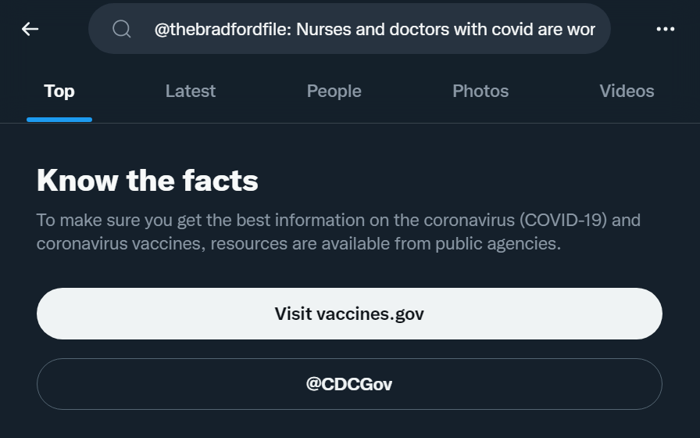

Slide 10
Lessons Learned
What went well?
  Learned more about NLP
  Learned about how to use a GPU cluster
  Learned from other presentations
What could we have done differently?
  Learned how to better scale the data

Slide 11
Publications/Contributions
Possibly SC22

