Slide 1
Deep-learning facilitated microscopy for the dissection of durable resistance to plant disease
Student: Hening Cui, Columbia University
Mentor: Anita Schwartz , University of Delaware
Researcher: Jeffrey Caplan,
Philip Saponaro,
Randall Wisser;
University of Delaware
Date: 01/18/2023

Slide 2
Background
High-speed confocal microscopy on plant-fungal interactions
Developing separate algorithms to extract individual features
DeepXScope
single deep convolutional neural network architecture
automatically segmenting hyphal networks of the fungal and host plant cell
Minker, K. R ., et al., 2018
Notes:
three-dimensional (3D) image data across large areas of maize leaf tissue infected with fungal pathogens

Slide 3
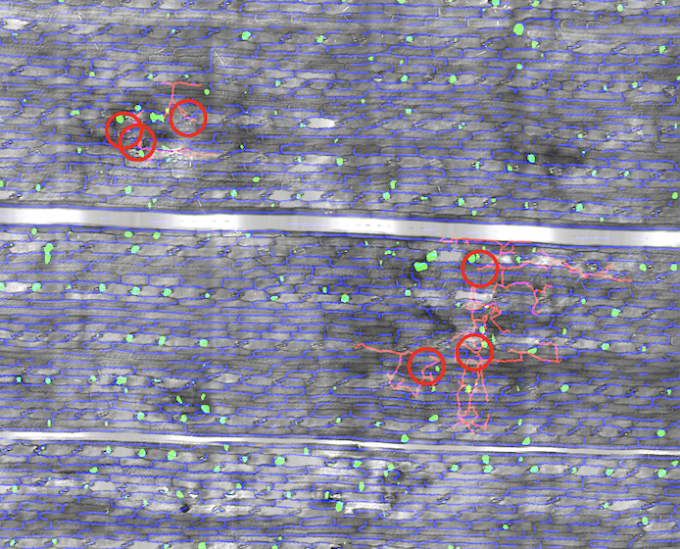
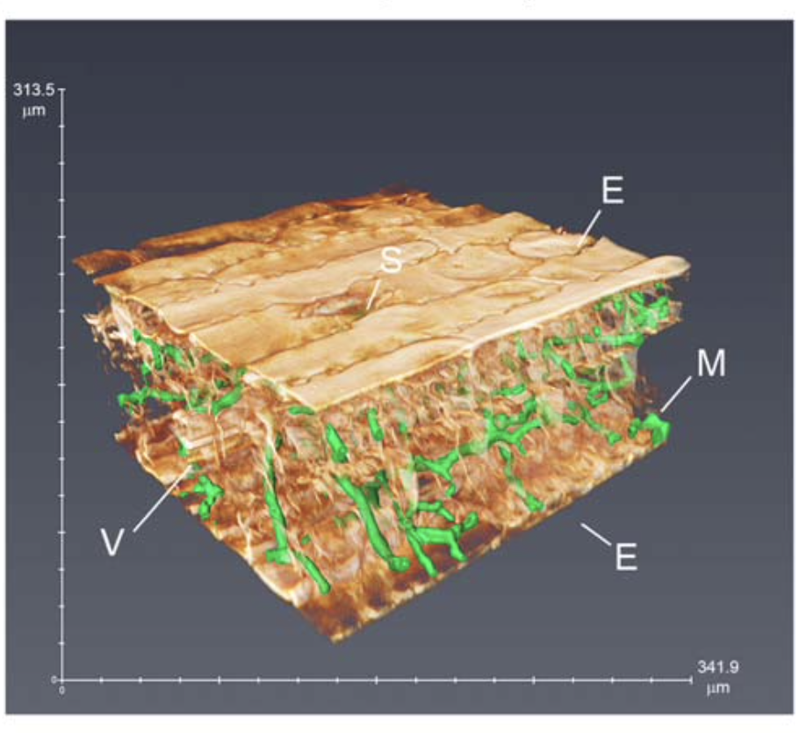
Minker, K. R ., et al., 2018

Slide 4
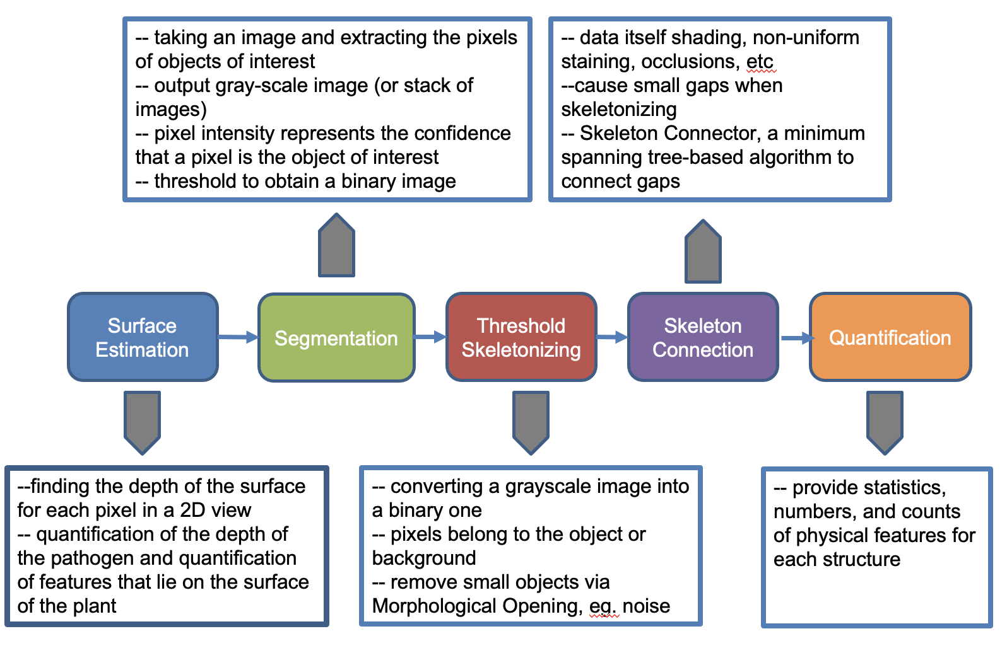
Process schema
Saponaro, P. et al.,2017

Slide 5
Timeframe
Start date: June 14th
End date: January 18th

Slide 6
Goals
Familiar with DeepXScope pipeline functions, installation, and how to process images, writing updates to the public README as needed
Run DeepXScope on existing and incoming datasets to generate standardized output to be shared with the research team
Test the pipeline on data collected from two other microscopy platforms
Produce a publication quality graphical schema describing the pipeline and user interaction
Manually annotated training data from other two dataset

Slide 7
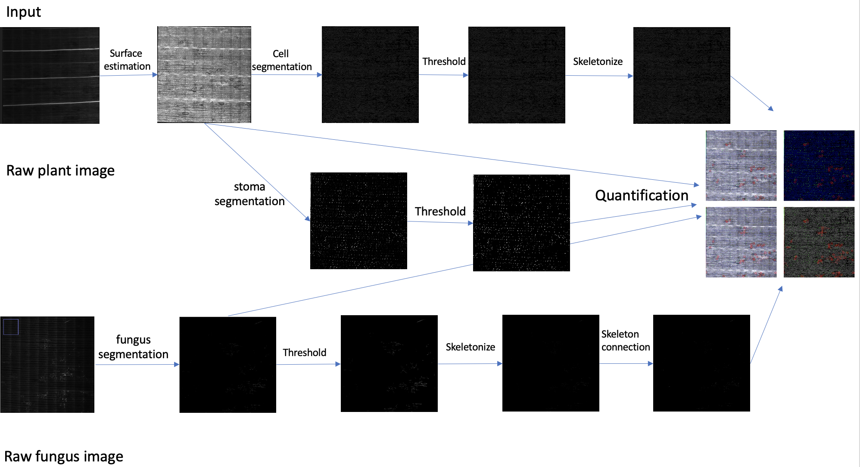
Result
Install DeepXscope on both Windows and Linux
Run the pipeline example image
Update the Readme

Slide 8
Result
Successfully install the DeepXScope on the Caviness HPC cluster
Run DeepXscope on existing dataset and two other dataset
Segmentation:
normalization_factor: input image pixels are divided by this value to normalize the pixel range
clip_value: clip image pixels that lie above the clip_value
Threshold: Otsu's auto-thresholding , Manually
Add the split raw data process
Summary the whole process in the Readme

Slide 9
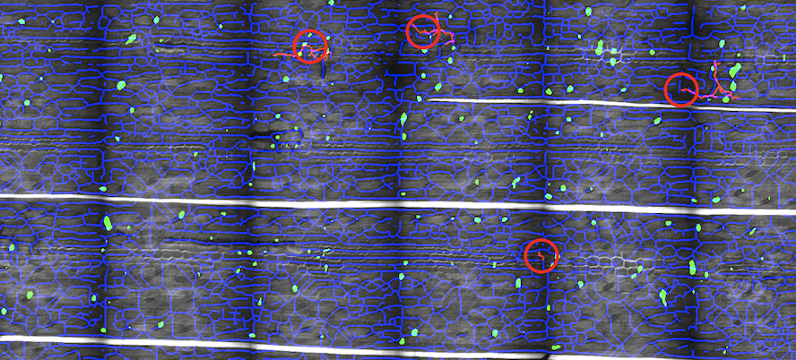
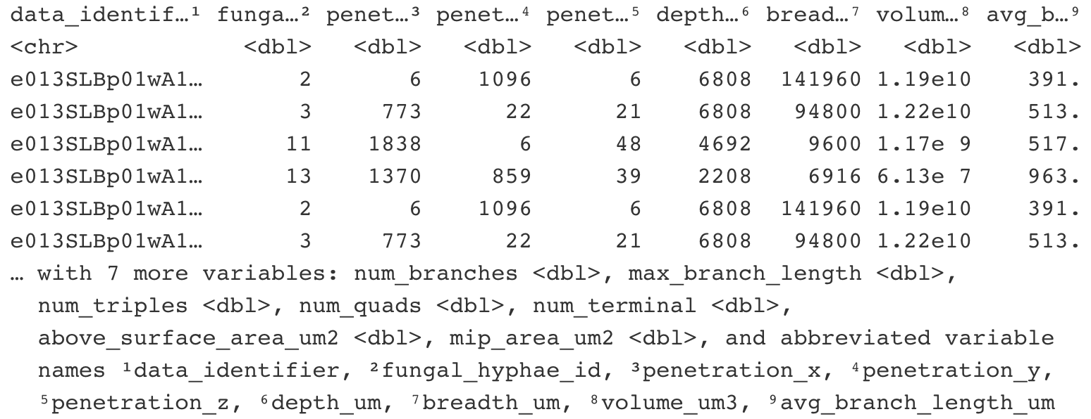
Result

Slide 10
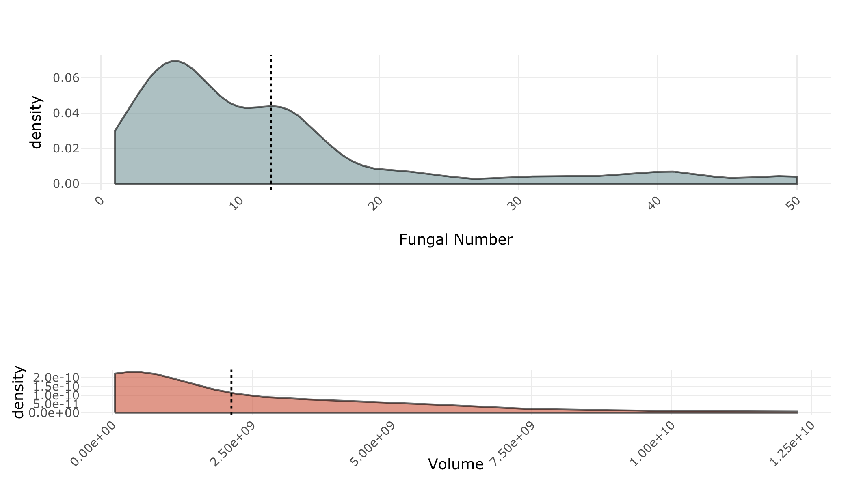
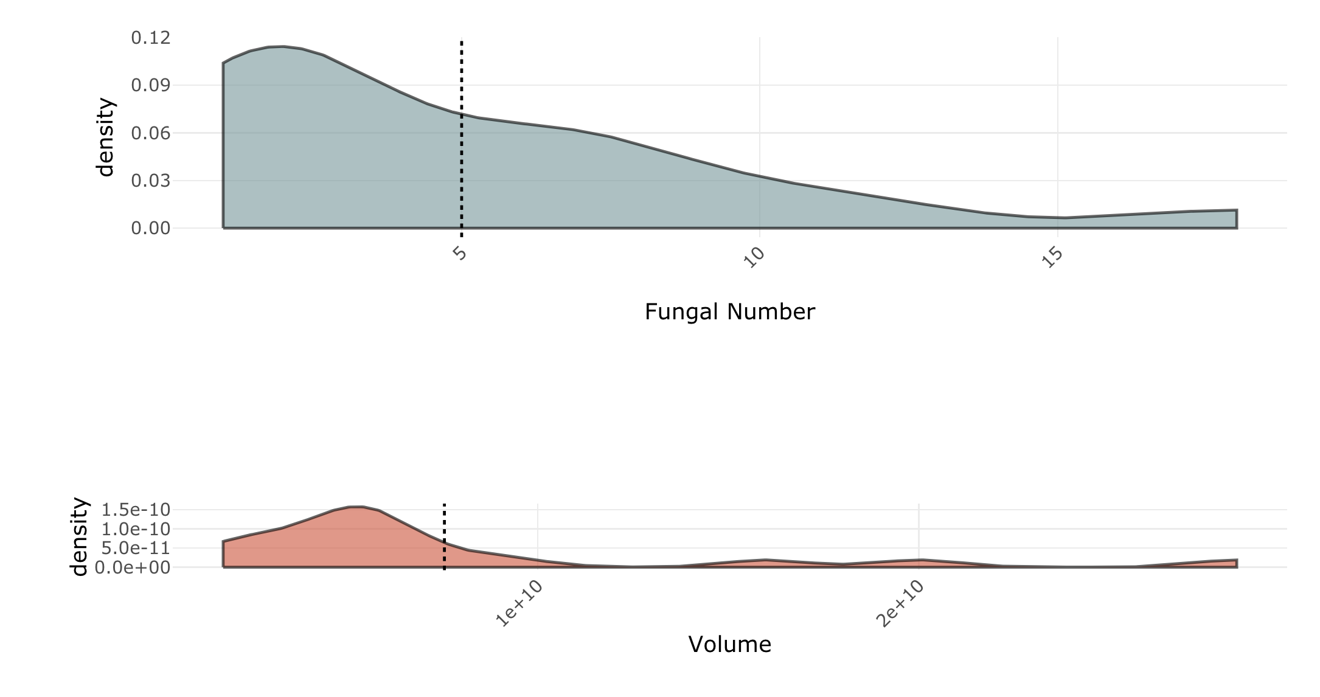
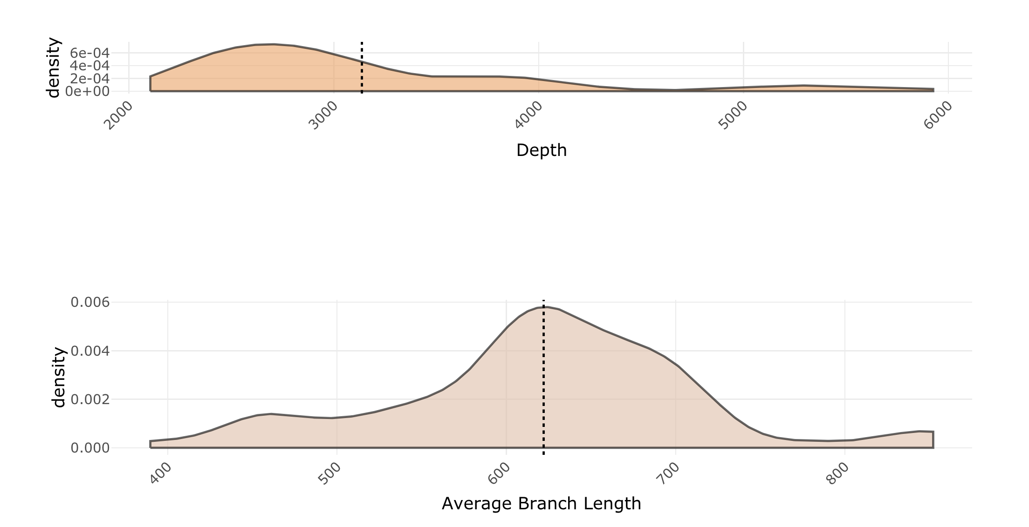
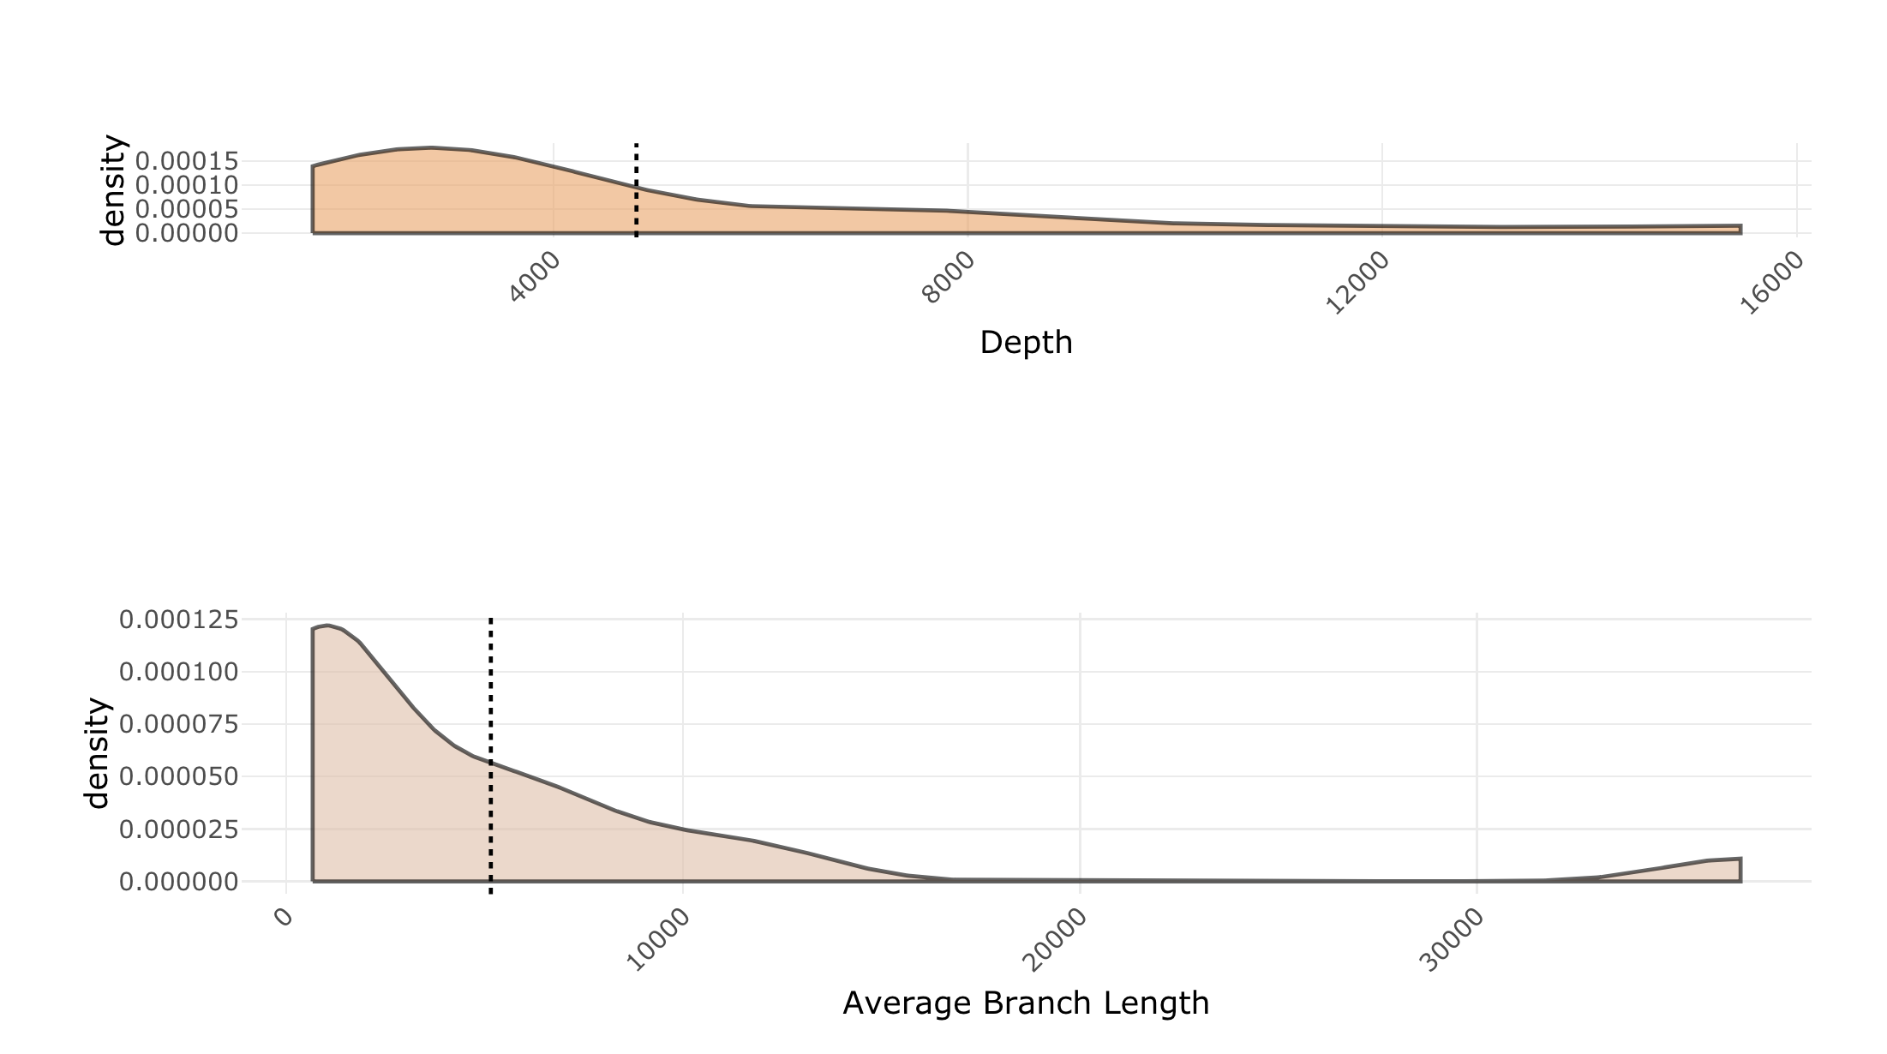
Result —Density Distribution
e013SLB
Bard

Slide 11
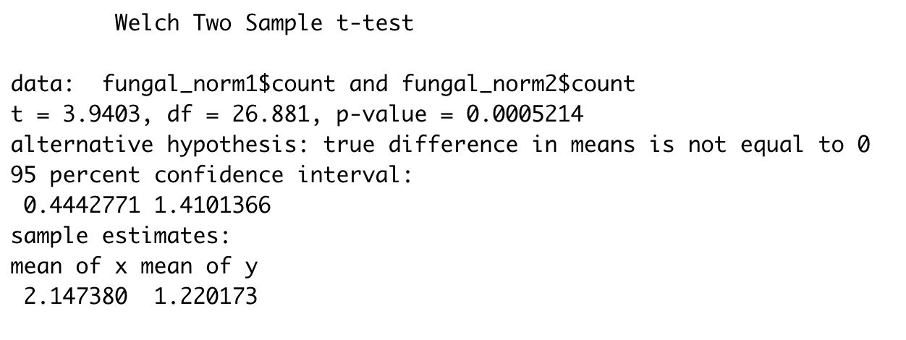
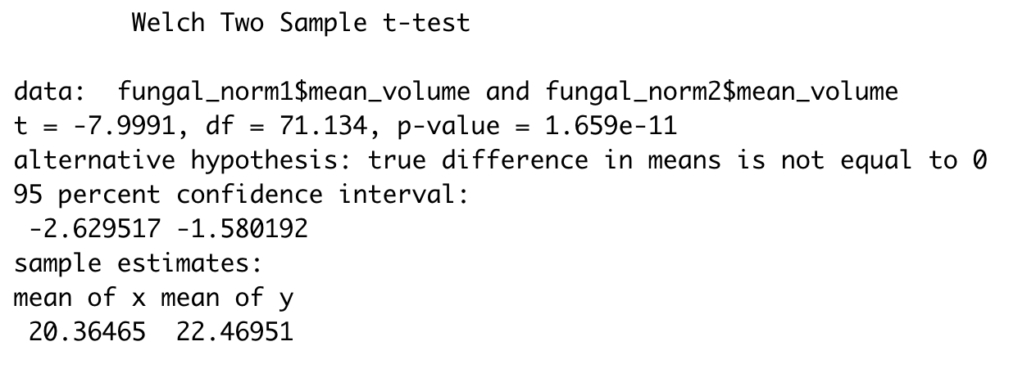
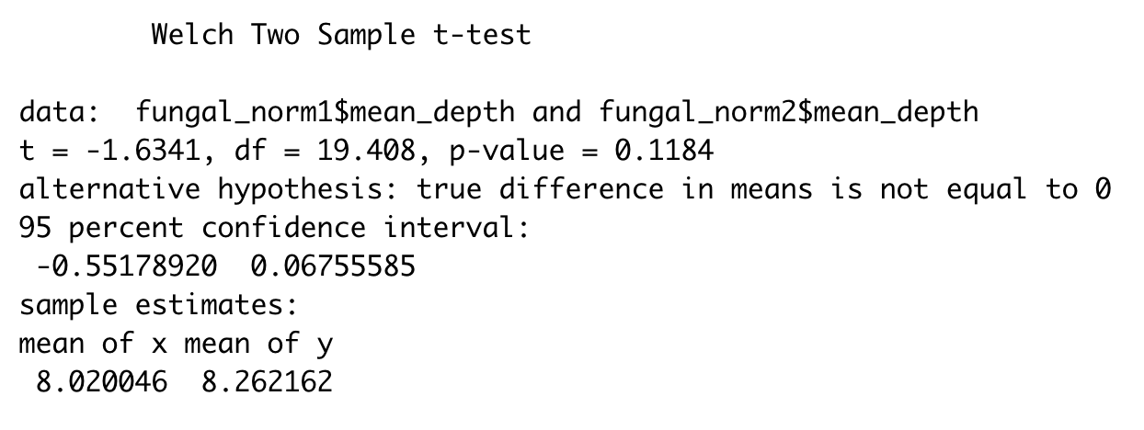
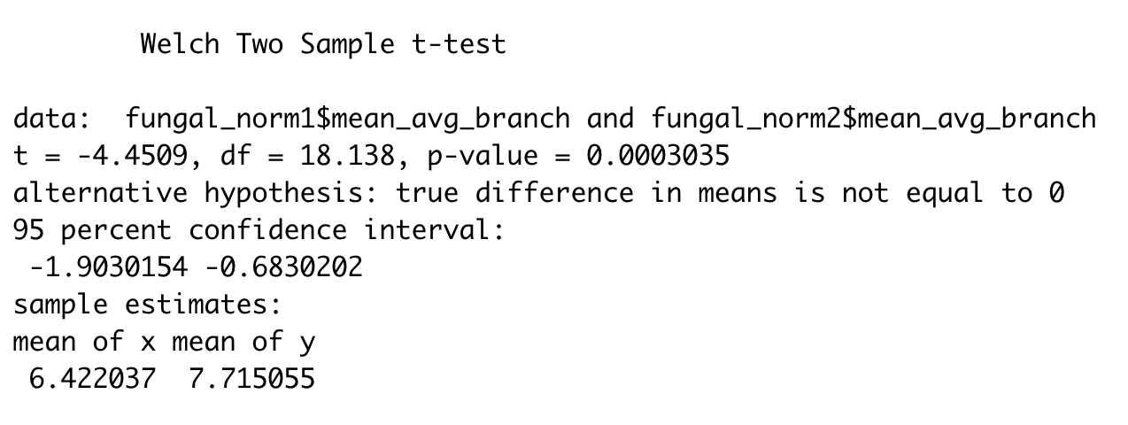
Result
Fungal Number
Fungal Volume
Fungal Depth
Average Branch Length
Normalization(log transformation)
Two sample test with equal variance
e013SLB has more fungal, but Bard fungal has longer hyphae and larger volume

Slide 12
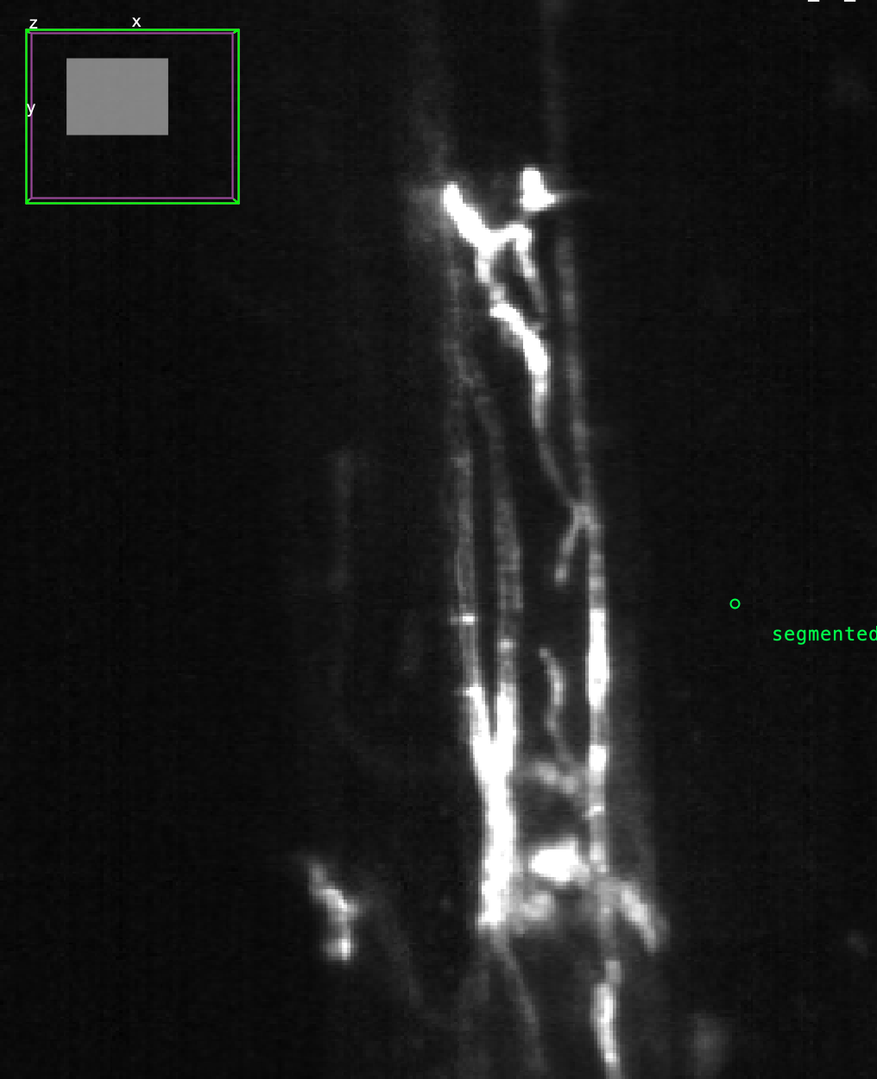
Manually Annotated Data
Labkit
Mark background/fungal
Machine Learning Segmentation
3D raw data stack
Labkit result
Manually adjusted

Slide 13
Future research
More manually annotated data to retrain the CNN model
Skeleton connection parameter adjust
Quantification feature standard accuracy check method

Slide 14
Acknowledgement
Thanks to Anita and Jeffery Frey’s help in the processing on Caviness
Thanks to Philip’s help in the pipeline of DeepXscope
Thanks to Jeffery Caplan’s help in the data annotation
Thanks to Randall’s help in the whole project instruction

Slide 15
References
Minker, K. R., Biedrzycki, M. L., Kolagunda, A., Rhein, S., Perina, F. J., Jacobs, S. S., ... & Caplan, J. L. (2018). Semiautomated confocal imaging of fungal pathogenesis on plants: microscopic analysis of macroscopic specimens. Microscopy research and technique, 81(2), 141-152.
Saponaro, P., Treible, W., Kolagunda, A., Chaya, T., Caplan, J., Kambhamettu, C., & Wisser, R. (2017). Deepxscope: Segmenting microscopy images with a deep neural network. In Proceedings of the IEEE conference on computer vision and pattern recognition workshops (pp. 91-98).

Slide 16
Thank You！
Q&A
Email：hc3212@columbia.edu
https://github.com/drmaize/compvision

