Slide 1
Computational Pipelines for the Analysis of Plastic-Degrading Genes
Student: Aidan McCrillis, University of Rhode Island
amccrillis@uri.edu
Mentor: Ying Zhang, University of Rhode Island
yingzhang@uri.edu
Researcher: Gaurav Khanna, University of Rhode Island
Date: 6/12/24
1

Slide 2
Pipelines for Plastic Degrading Genes
There a 399,000 tons of plastics in the ocean. 69,000 tons of this are microplastics (Buchholz, 2022).
Microplastics can’t be removed from the ocean easily.
Plastics are durable and don’t degrade well, so they’ll trickle down through the ecosystem
Microbial degradation is a possible solution to this problem
2

Slide 3
Pipelines for Plastic Degrading Genes
How can these genes be obtained?
  Its estimated that less than 2% of microbes can be cultured (Wade, 2002)
  Metagenomics is a solution to this problem
  Random sampling of genes directly over time (September 2017 - March 2020) rather than culturing
3

Slide 4
Pipelines for Plastic Degrading Genes
This project’s goal is to produce a workflow to make the analyses on this data set reproducible.
4

Slide 5
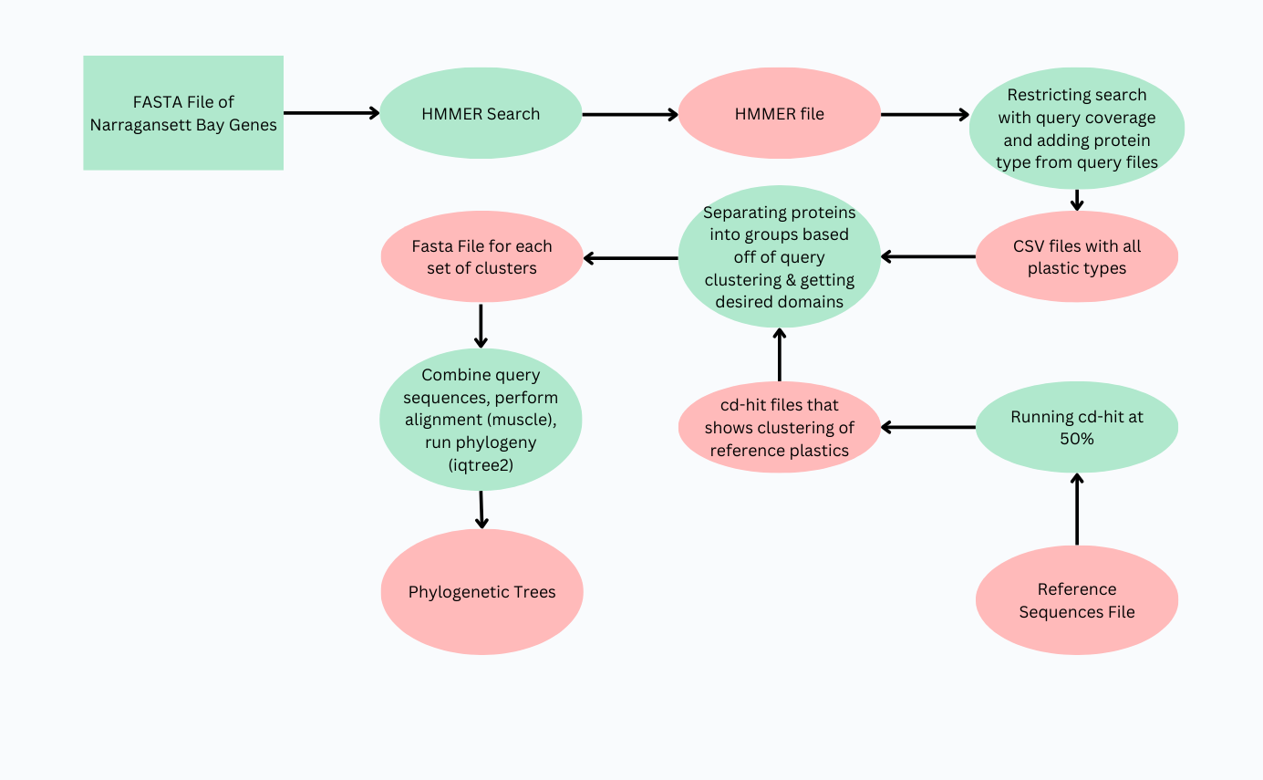

The Pipeline
5

Slide 6
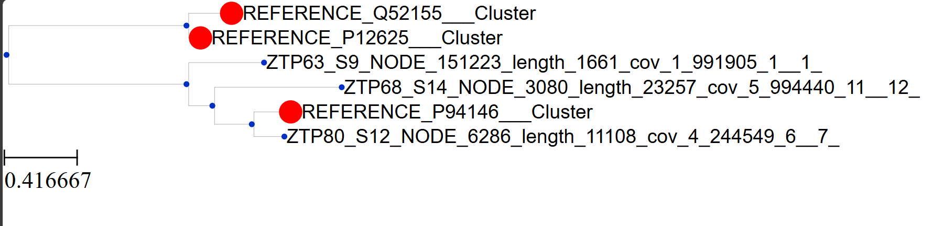
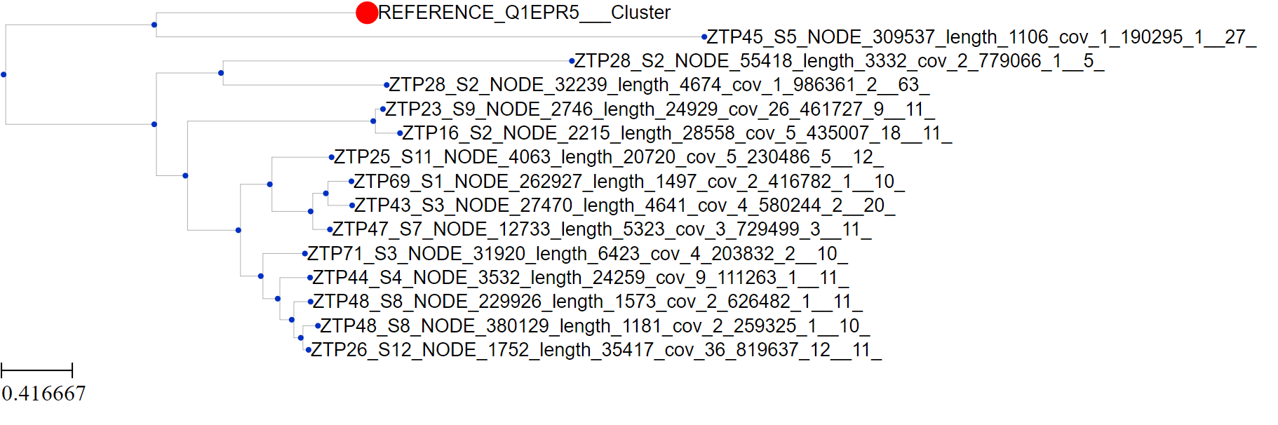
The Final Results
6

Slide 7
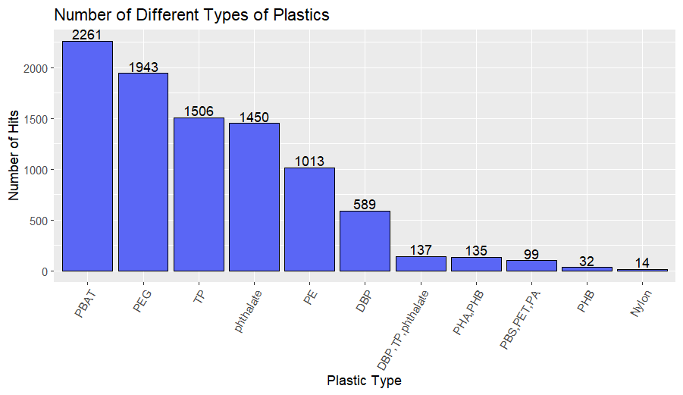
Number of Different Plastics
7

Slide 8
Workflow Reproducibility
Using Conda as a way for version control:
  For running the workflow, there are two environments that need to be setup from .yml files
  This makes the environment for the pipeline reproducible
8

Slide 9
Where to go after?
Examining the variability of the plastic degrading enzymes overtime
Looking at individual protein structures using a tool like Colabfold
Looking at what organisms are carrying these proteins
9

Slide 10
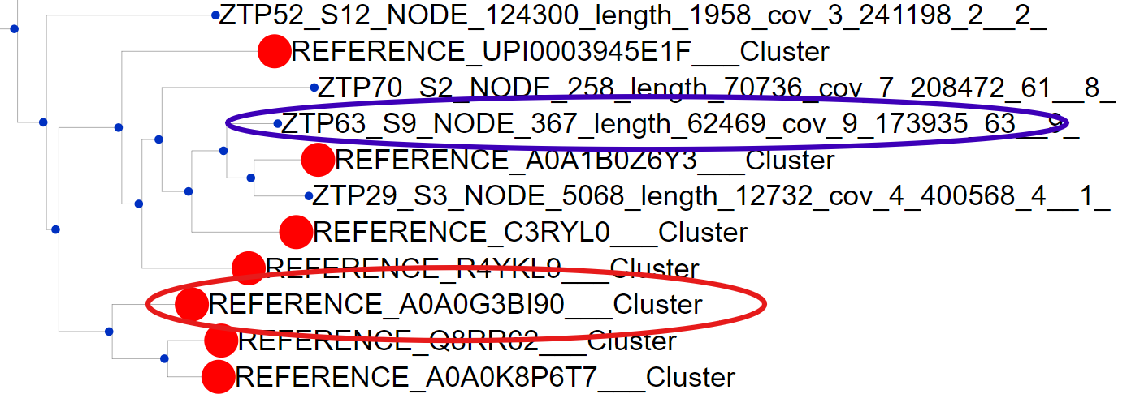
Examining an Individual Protein
Reference A0A0G3B190 is from a PETase degrading protein from Ideonella sakaiensis that was notable for it high catalytic activity on PET
10

Slide 11
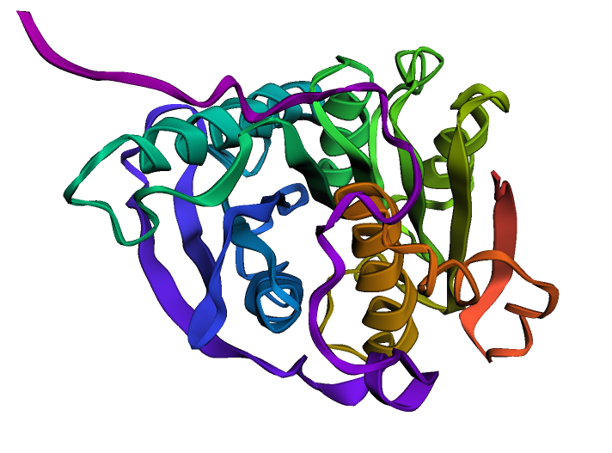
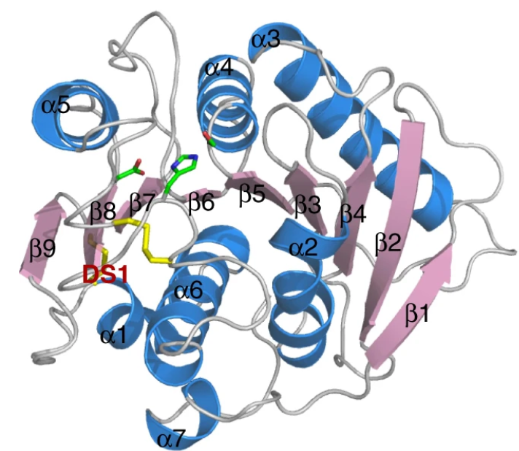
Colabfold
I. sakaiensis
Predicted structure of one the proteins we found
Han, X., Liu, W., Huang, JW. et al. Structural insight into catalytic mechanism of PET hydrolase. Nat Commun 8, 2106 (2017). https://doi.org/10.1038/s41467-017-02255-z
11

Slide 12
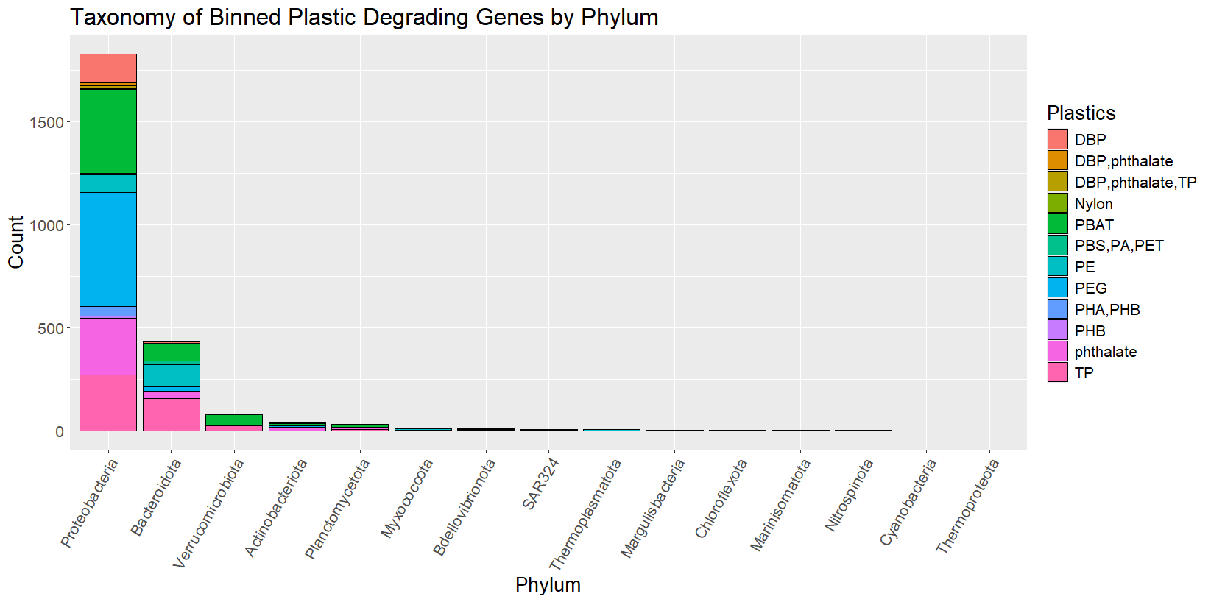
Obtaining Taxonomy of Binned Plastic Degrading Proteins
12

Slide 13
References
Wade W. Unculturable bacteria--the uncharacterized organisms
that cause oral infections. J R Soc Med. 2002 Feb;95(2):81-3.
doi: 10.1177/014107680209500207. PMID: 11823550; PMCID:
PMC1279316.
Buchholz, P.; Zhang, H.; Perez-Garcia, P.; Nover, L.-L.; Chow, J.; Streit,
W.R.; Pleiss, J. Plastics degradation by hydrolytic enzymes: The
Plastics-Active Enzymes Database-PAZy. Proteins 2021, 90, 1443–1456. Retrieved from:
https://onlinelibrary.wiley.com/doi/10.1002/prot.26325
BHan, X., Liu, W., Huang, JW. et al. Structural insight into catalytic
mechanism of PET hydrolase. Nat Commun 8, 2106 (2017).
https://doi.org/10.1038/s41467-017-02255-z
Zrimec J,Kokina M,Jonasson S, Zorrilla F, Zelezniak A, 2021. Plastic-Degrading Potential
across the Global Microbiome Correlates with Recent Pollution Trends. mBio
12:10.1128/mbio.02155-21.
https://doi.org/10.1128/mbio.02155-21
13

Slide 15
Github
https://github.com/zhanglab/PDG-finder

