Slide 1
Neural Network Surrogate Models of Gravitational Waveforms
Student: Ashwin Girish, University of Rhode Island
ashwin.girish@uri.edu
Mentor: Dr. Scott Field, University of Rhode Island
sfield17@uri.edu
Date: June 21, 2024

Slide 2
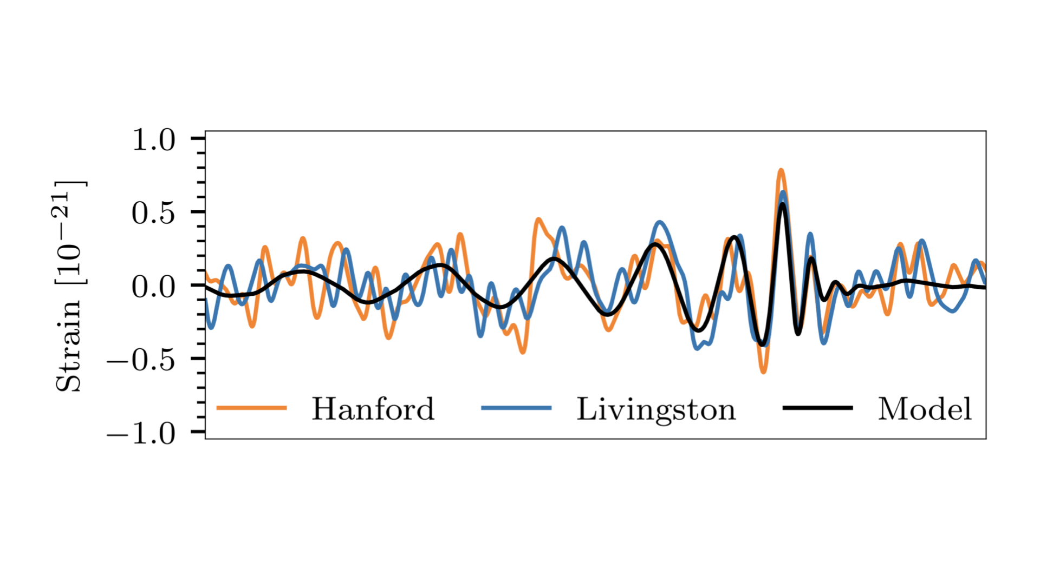
Neural Network Surrogate Models of Gravitational Waveforms
The Gravitational Wave Signal emitted by a binary black hole merger is an oscillatory ‘chirp’, whose amplitude and frequency peak at merger.
These signals are complex, and hence difficult to model.
Complexity arises due to the number of dependent parameters, higher-order modes of oscillation, precession, orbital eccentricity etc.

Slide 3
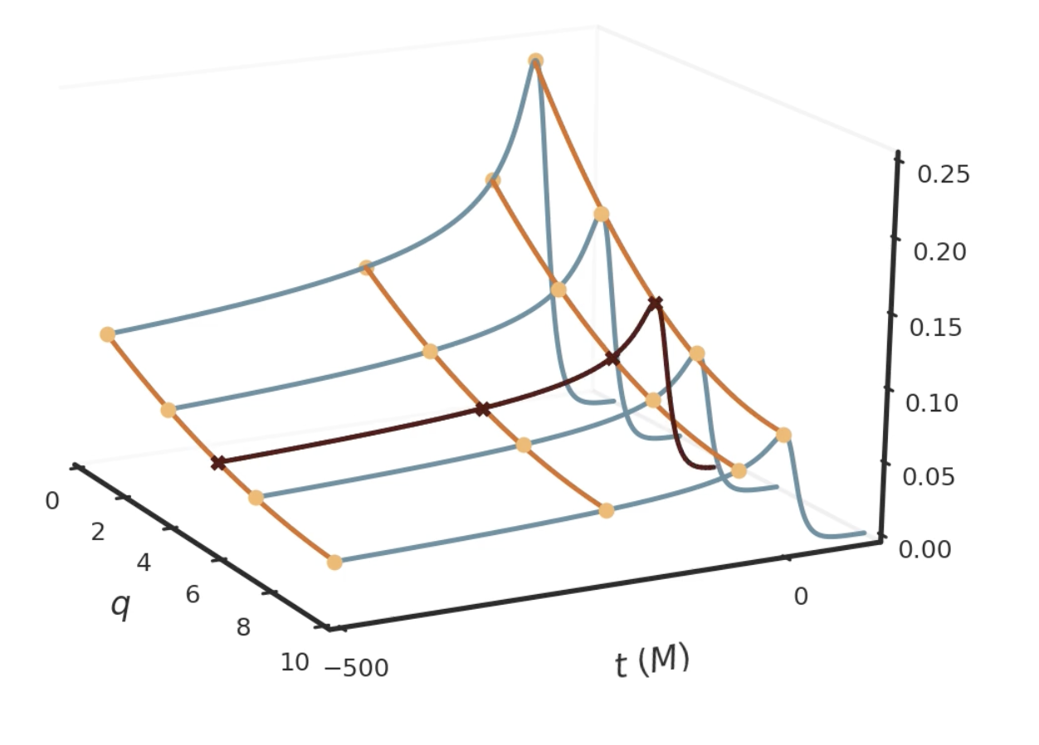
Neural Network Surrogate Models of Gravitational Waveforms
Surrogate models construct waveform models directly from waveform data, sampled either from another model, or from simulations.
Surrogate models perform this construction using expansions in orthogonal bases and interpolation methods.

Slide 4
Neural Network Surrogate Models of Gravitational Waveforms
Goals:
  Extend existing surrogate models by using Artificial Neural Networks (ANNs) to perform interpolation. An appropriately constructed ANN should be able to perform this interpolation with high accuracy and speed.
  Start by modelling sections of a precessing GW waveform with ANNs, and optimising their hyperparameters to best model the waveform.

Slide 5
Neural Network Surrogate Models of Gravitational Waveforms
Timeframe
  Start date: June 17, 2024
  End date: August 31, 2024

Slide 6
Neural Network Surrogate Models of Gravitational Waveforms
What I hope to learn
  How to construct and optimise neural networks for this task
  How to run efficient scripts that utilise UNITY’s resources judiciously
  How to manage and contribute to existing codebase on GitHub

Slide 7
Neural Network Surrogate Models of Gravitational Waveforms
Goals for Next Month:
  Familiarise myself with PyTorch and Optuna, the python libraries that are used to construct the ANN, and optimise its hyperparameters respectively.
  Construct simple ANNs that infer waveforms using NR simulation data and optimise the hyperparameters of these networks

