Slide 1
Neural Network Surrogate Models of Gravitational Waveforms
Student: Ashwin Girish, University of Rhode Island
ashwin.girish@uri.edu
Mentor: Dr. Scott Field
sfield17@uri.edu
Date: September 11, 2024

Slide 2
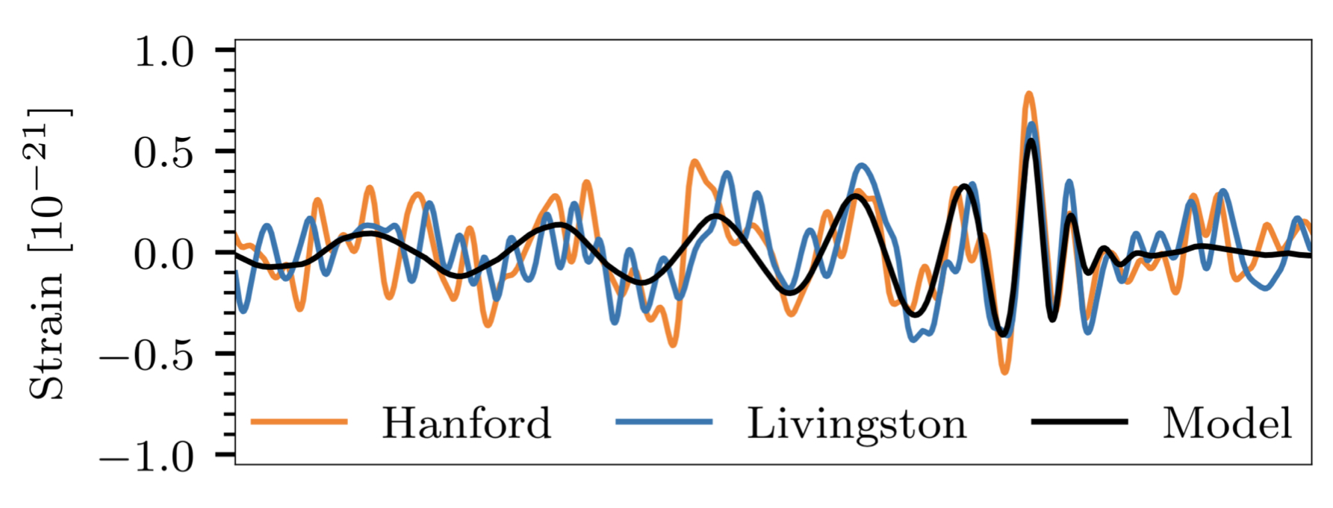
Neural Network Surrogate Models of Gravitational Waveforms
The Gravitational Wave Signal emitted by a binary black hole merger is an oscillatory ‘chirp’, whose amplitude and frequency peak at merger.
These signals are complex and oscillatory. Since oscillatory signals are difficult to interpolate, the amplitude and phase are studied separately.
Complexity arises due to the number of dependent parameters, higher-order modes of oscillation, precession, orbital eccentricity etc.
Surrogate models construct waveform models directly from waveform data, sampled either from another model, or from simulations.

Slide 3
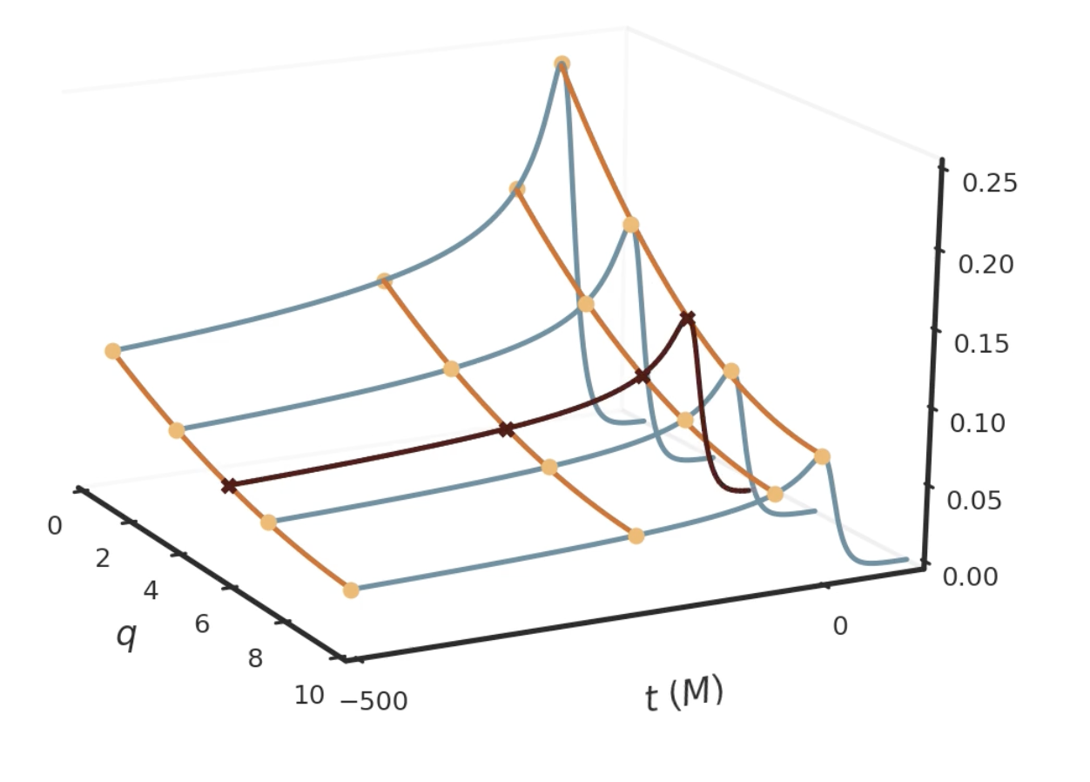
Neural Network Surrogate Models of Gravitational Waveforms
Step 1: Iteratively construct a reduced basis set of waveforms (Blue)
Step 2: Reduce data in time direction to most representative times (Yellow)
Step 3: Construct fits across parameter space at representative times (Orange)
Step 4: Evaluate fits at random parameter set, and estimate waveform (Maroon)

Slide 4
Neural Network Surrogate Models of Gravitational Waveforms
Milestone 1: Install and run existing Python codes on Unity; run interactive examples on CPU and GPU.
Milestone 2: Write and submit job submission scripts for Unity for various target problems.
Milestone 3: Carry out hyperparameter optimization studies for various target problems

Slide 5
Neural Network Surrogate Models of Gravitational Waveforms
Timeframe
  Start date: June 17, 2024
  End date: August 31, 2024

Slide 6
Neural Network Surrogate Models of Gravitational Waveforms
Milestone 1:
Scripts optimise hyperparameters that describe an artificial network and return the set that minimises validation error.
These scripts use PyTorch to construct the ANN, and Optuna to optimise hyperparameters. The script also saves the best performing ANN.
Milestone 2:
Focused on modelling the phase of the gravitational wave
Goal: Find the network parameters that minimizes the “Dephasing”, the phase difference between the waveform dataset and ANN output
Initial runs of Optuna gave us general ranges and preferences for network hyperparameters.

Slide 7
Neural Network Surrogate Models of Gravitational Waveforms
Milestone 3:
Initial runs used to choose regions in the hyperparameter space to study in more depth.
Optuna script modified to allow for command line inputs that restrict ranges of the hyperparameters. These modifications will be made publicly available on GitHub.
The table on the next slide summarises results from more constrained optimisation tasks.

Slide 8
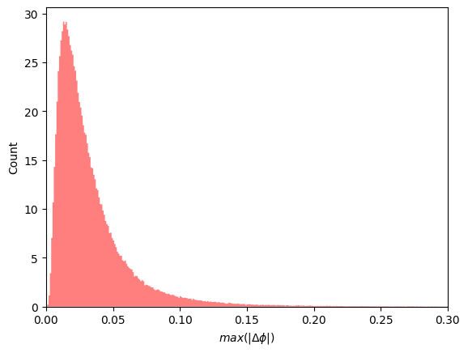
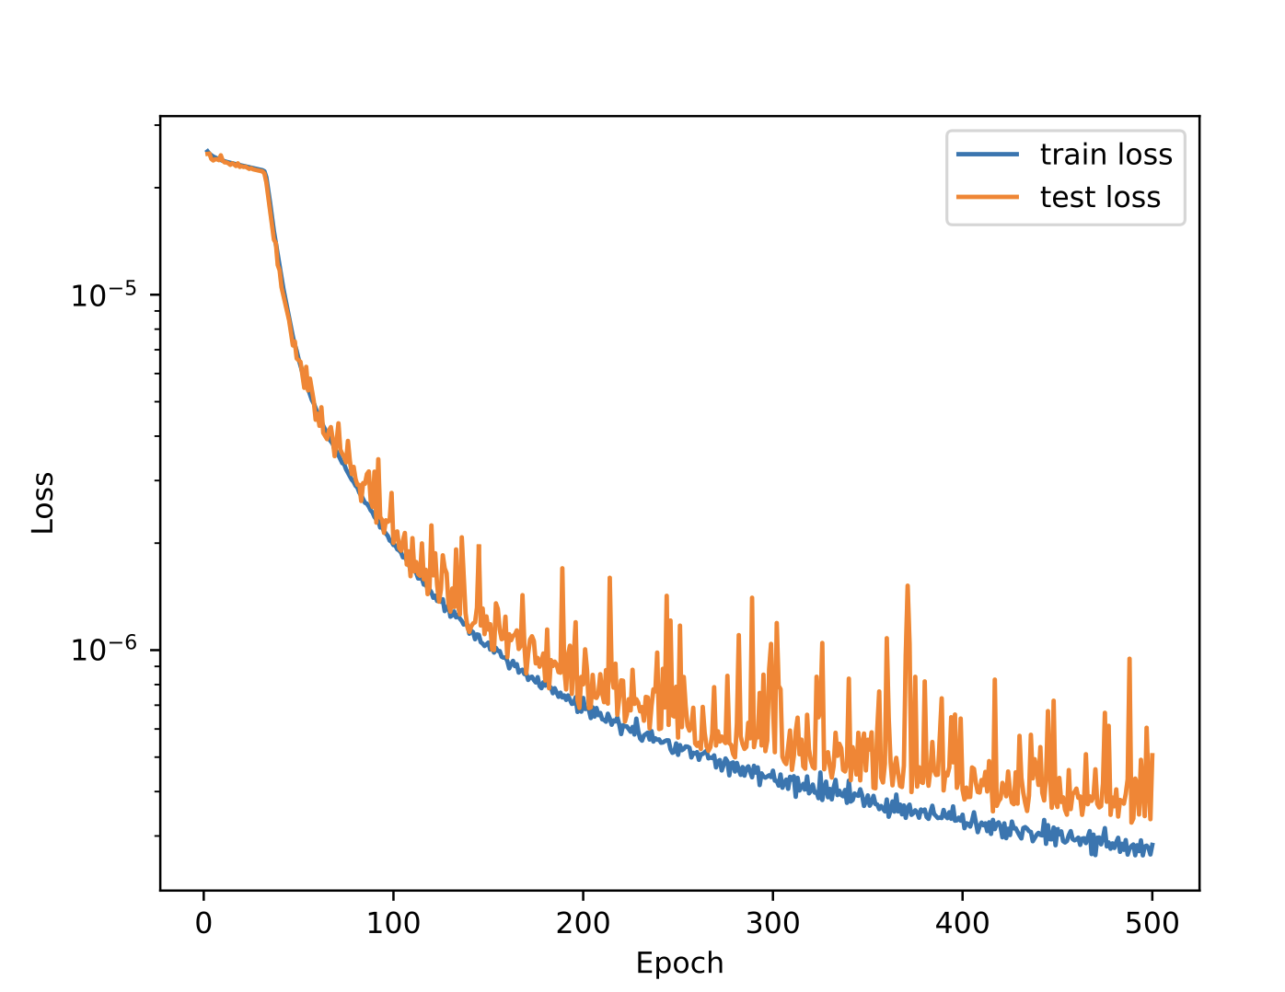
test_loss | n_layers | n_units | acf | lr | shape | dephasing |  | total_n_params | Epochs
 |  |  |  |  |  | maximum | median
3.97E-07 | 8 | 560 | ELU | 2.94E-05 | Constant | 2.940605196 | 0.025040561 | 2332630 | 500
4.18E-07 | 24 | 256 | ELU | 2.94E-05 | Constant | 4.440829061 | 0.0259344711 | 1574374 | 500
4.87E-07 | 8 | 560 | ELU | 1.49E-05 | Constant | 2.467359115 | 0.0286719992 | 2332630 | 500
4.98E-07 | 8 | 496 | ReLU | 0.000133 | Constant | 2.426759599 | 0.024326319 | 1843862 | 500
5.52E-07 | 6 | 560 | ELU | 2.94E-05 | Constant | 2.669431467 | 0.019046397 | 1704310 | 500
5.54E-07 | 12 | 352 | LeakyReLU | 2.94E-05 | Constant | 2.127912558 | 0.028757357 | 1450822 | 500
5.83E-07 | 12 | 352 | ReLU | 0.000158 | Constant | 3.38542904 | 0.034590154 | 1450822 | 500
6.75E-07 | 24 | 256 | ELU | 0.0001329 | Constant | 2.975634703 | 0.032982800 | 1574374 | 500
7.45E-07 | 8 | 432 | LeakyReLU | 0.000197 | Constant | 3.679288004 | 0.0494196497 | 1412438 | 500
Results from Optuna runs for best sets of network parameters
Trial with lowest test loss (8 Layers, 560 units per layer)

Slide 9
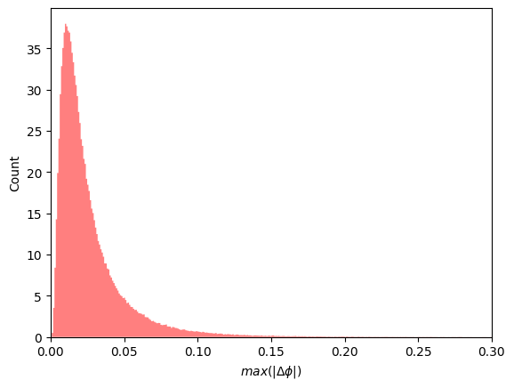
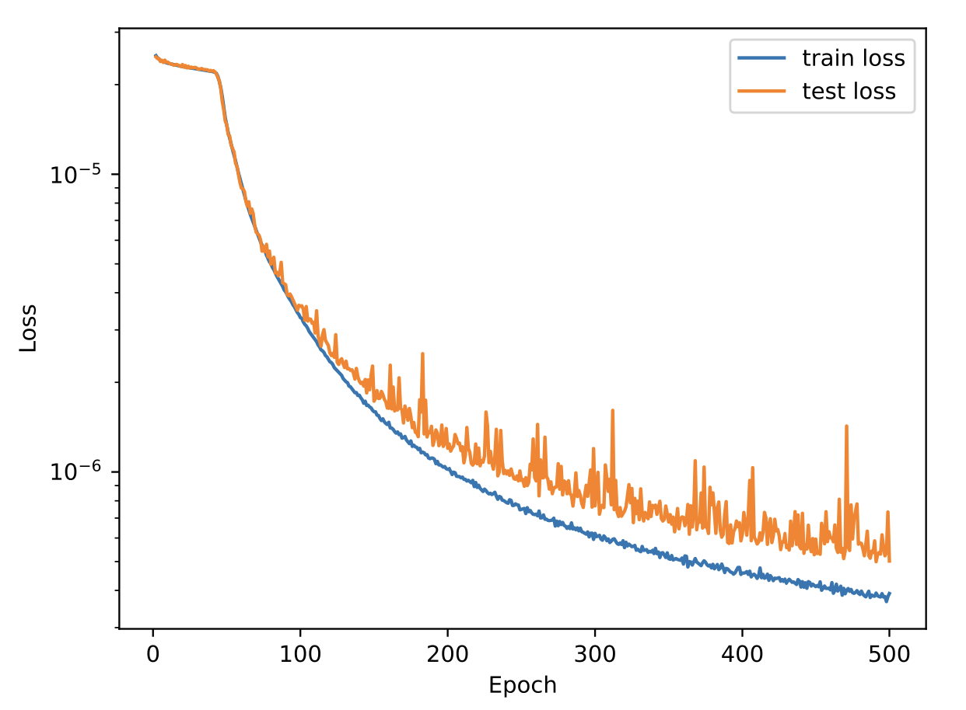
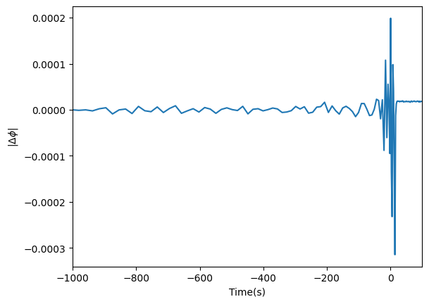
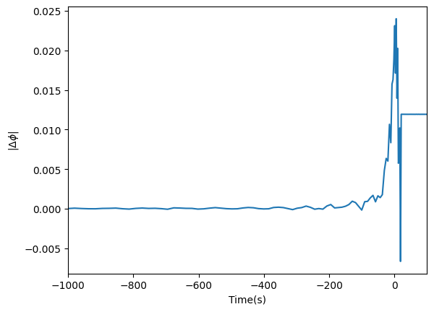
Trial with lowest median dephasing (6 Layers, 560 units per layer)
Test cases with the least and most dephasing

Slide 10
Lessons Learned and Future Work
Challenges:
  Optuna doesn’t support dynamic variable spaces for categorical variables.
  More dephasing seen around the merger and ringdown, suggesting that the ANN faces difficulty in learning the phase behaviour in this regime.
Lessons Learnt:
Better understanding of the structure of surrogate models
Learnt about the construction of neural networks and how to optimise their structure to cater to specific problems
Learnt to write better job scripts that use UNITY’s resources efficiently
Future Work:
Construct similarly optimised ANNs for other waveform pieces
Compare evaluation times between the original spline interpolated surrogate and the neural network surrogate

