Slide 1
A Multimodal Analysis of Embedded Climate Change Media on Twitter
Student: JACOB S DAUPHINAIS, University of Rhode Island
jacdauphinais@uri.edu
Mentor: DR. SUHONG LI, Bryant University
sli@bryant.edu
Project Owner: DR. GAURAV KHANNA, University of Rhode Island
gkhanna@uri.edu
12 March 2025

Slide 2
Project Description
A Multimodal Analysis of Embedded Climate Change Media on Twitter
Seeks to analyze video and image elements of Twitter/X posts in their association to climate change
Focus on data pipeline to create textual descriptions using Large Language Models

Slide 3
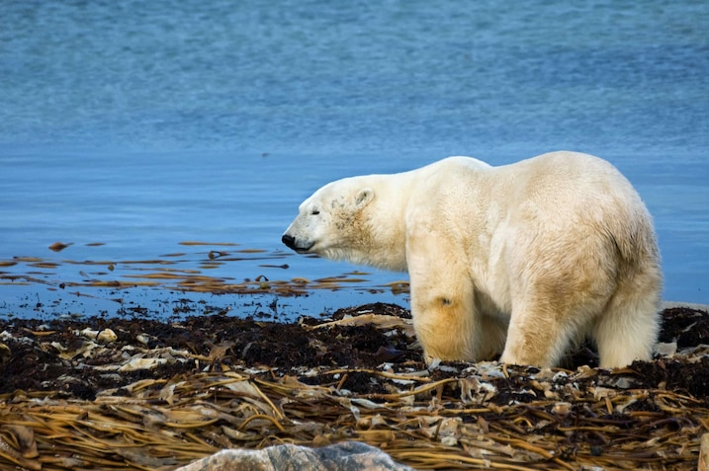
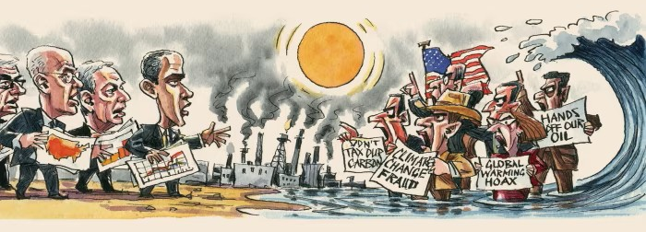
Examples of Climate Change Visual Representation
A Multimodal Analysis of Embedded Climate Change Media on Twitter
Photograph by Cindy Creighton, Shutterstock
Obtained from National Geographic Kids
Political cartoon by Ingram Pinn
Obtained from article “Climate sceptics are losing their grip” from the Financial Times Opinion section

Slide 4
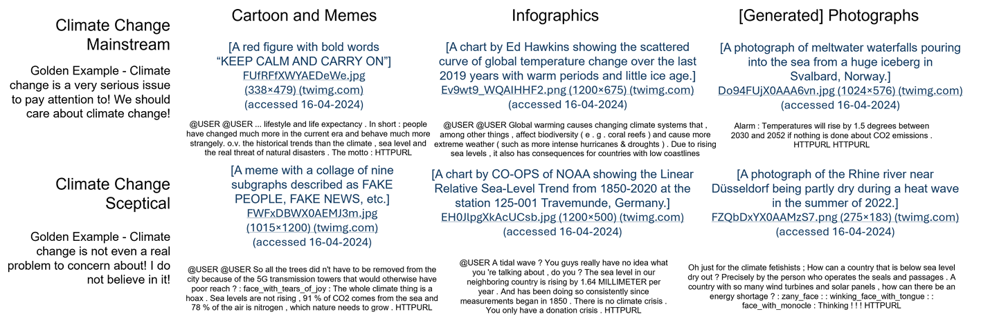
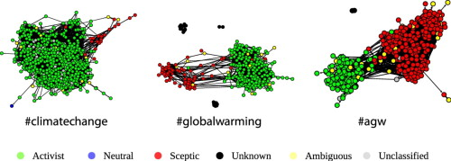
Prior Research on Climate Change Methodology
A Multimodal Analysis of Embedded Climate Change Media on Twitter
Examples from the collected multimodal dataset of climate change stances; Bai, Nan (2024)
Graphical abstract; Williams, Hywel (2014)

Slide 5
Goals
A Multimodal Analysis of Embedded Climate Change Media on Twitter
  Develop a methodology for video and image processing using open-source LLMs
  Test multiple open-source LLMs for effectiveness in analyzing visual media
  Perform and use sentiment and topic analysis on extracted visual content
  View potential differences/similarities between text-focused and visual media focused climate change posts

Slide 6
Project Timeline
A Multimodal Analysis of Embedded Climate Change Media on Twitter
February 2025
- Start and finalize literature review
- Research existing multimodal analysis data flow to develop method of data processing
- Create GitHub project and connect to the UNITY cluster
March 2025
- Research and create list of viable LLMs to use in the project pipeline
- Ensure data pipeline will function using small tests
- Begin main larger batch processing for multiple LLMs
April 2025
- Continue and finish LLM batches if necessary
- Perform analysis on the now textual data from the visual media
- Compare to previous researches findings and document
- Begin final report on findings
May 2025
- Finalize any portions of research and analysis remaining
- Wrap Presentation May 14th, 2025

Slide 7
Learning Points
A Multimodal Analysis of Embedded Climate Change Media on Twitter
A deeper understanding of Large Language Models and their use in multimodal analysis
Working in a cluster system such as the UNITY cluster effectively, such as with large resource jobs, batch jobs, etc.
Data visualization principles using results from LLMs and multimodal analysis

Slide 8
Goals Following Launch Presentation
A Multimodal Analysis of Embedded Climate Change Media on Twitter
Create list of LLMs to use and finalize base project on GitHub
Further research other AI/ML Models and data pipelines regarding multi-modal analysis
Refine data pipeline of how data will be extracted, processed, and stored

Slide 9
Questions or Comments?
A Multimodal Analysis of Embedded Climate Change Media on Twitter
Any other questions can be directed to jacdauphinais@uri.edu

